Slide 1
MSDS 453 Text Analytics
Final Presentation: Tamara Williams

Slide 2
Solo Project using non-US Press articles
Corpus made up of 15 DSIs
All drawn from non-US press sources
13 DSIs unique to this corpus, 1 from Cohort 11, and my DSI contribution to Cohort 12
Trade, war in Syria, and Trump as seen in the rest of the world made up the basic topics
Primary question of interest was seeing how these articles clustered
Secondary question of interest was seeing how these articles clustered when added to the corpus from Cohort 12

Slide 3
Approach
Multiple techniques were used
Clustering against the full text of the corpus
Clustering using RTVs only
LDA against the full text of the corpus
Clustering against the full text of the corpus gave surprisingly good results
Best clustering results were achieved using the 7th iteration of the RTV
Lingering questions over the location of some DSIs in their assigned clusters
LDA results somewhat ambiguous
Some topics make sense while others do not

Slide 4
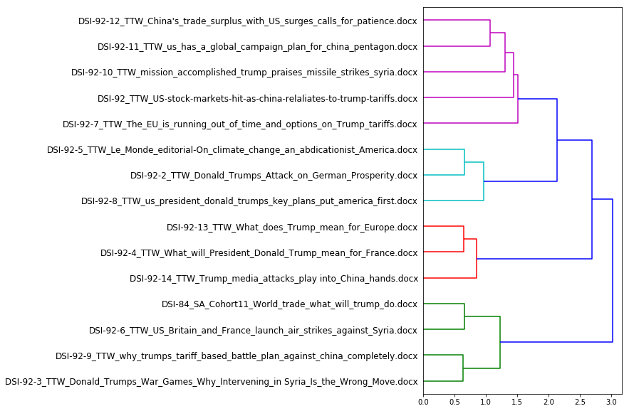
Interpretation of Cluster Results
For the most part, the clustering makes sense to me. I can come up with meaningful labels for 3 of the 4 groups
Aqua – Isolationist Trump policy impacts in Europe
Red – General Trump policies in Europe
Green – France and Britain in the Trump era
Purple – This one a a mixed bag, it has the war in Syria and trade articles
I’d basically label this one “Trump behaviors”
Try as I might, I was never able to get all the Syrian war articles to cluster together
Note: DSI-92-10, 11, and 12 come from Asia, whereas DSI-92-3 and 6 come from Europe; possible regional influence in the clustering?

Slide 5
Details of the Explorations Done

Slide 6
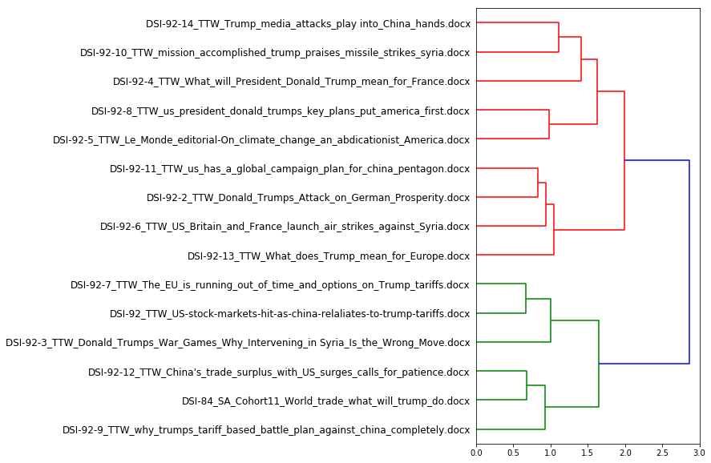
First pass RTV
174 Total terms
ECs not yet handled
Lots of 1’s and 2’s, words only appearing once

Slide 7
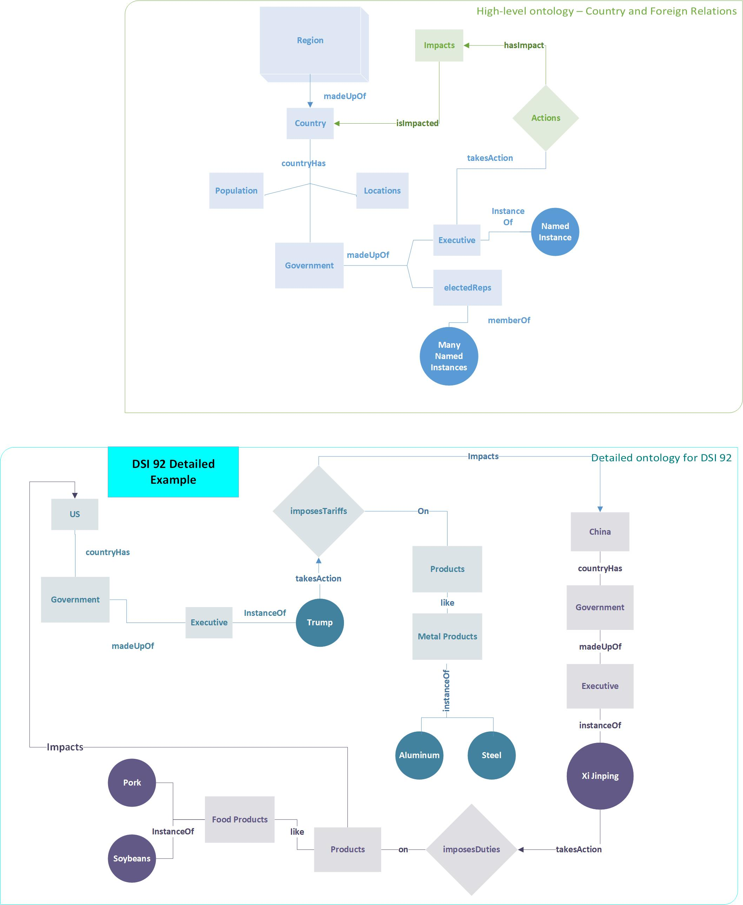
Ontology – DSI 92
Numerous drafts
Each draft became clearer and more refined
Example is for one of the DSIs in the corpus, drawings were not made for all documents

Slide 8
Revised ETCs
Final version of the RTV/EC list is down to 46 terms and ecs

Slide 9
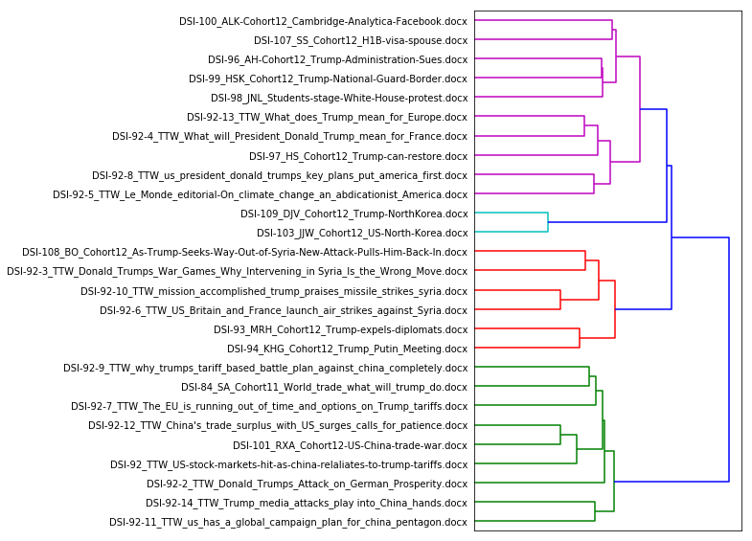
My Corpus combined with Cohort 12
See how my non-US documents tend to be more closely grouped together, even when in clusters on the same topic

Slide 10
LDA comparison – 5 topics
Topics – My corpus
Topics – My corpus + cohort 12
topic: 0
['trade', 'deal', 'countri', 'polici', 'deficit', 'plan', 'elect', 'also', 'agreement', 'year', 'world', 'new', 'withdraw', 'includ', 'job', 'look', 'energi', 'foreign', 'industri', 'tax']
topic: 1
['tariff', 'automobil', 'execut', 'face', 'would', 'becom', 'also', 'good', 'announc', 'say', 'year', 'threat', 'respons', 'collect', 'last', 'produc', 'free', 'seem', 'slap', 'product']
topic: 2
['trade', 'tariff', 'said', 'market', 'product', 'war', 'littl', 'want', 'point', 'steel', 'countri', 'would', 'continu', 'could', 'global', 'attack', 'economi', 'though', 'export', 'like’]
topic: 3
['billion', 'trade', 'said', 'media', 'tariff', 'war', 'would', 'last', 'press', 'presid', 'benefit', 'say', 'parti', 'told', 'issu', 'repeat', 'like', 'concern', 'month', 'side’]
topic: 4
['said', 'chemic', 'attack', 'weapon', 'militari', 'respons', 'strike', 'one', 'global', 'week', 'plan', 'regim', 'alli', 'even', 'use', 'presid', 'threat', 'world', 'made', 'nation']
topic: 0
['said', 'elect', 'respons', 'use', 'would', 'call', 'countri', 'campaign', 'diplomat', 'data', 'plan', 'announc', 'order', 'action', 'global', 'offici', 'report', 'trade', 'execut', 'world']
topic: 1
['plan', 'polici', 'energi', 'tax', 'includ', 'militari', 'defenc', 'foreign', 'job', 'trade', 'focus', 'key', 'back', 'develop', 'group', 'nation', 'system', 'everi', 'new', 'defens']
topic: 2
['said', 'would', 'state', 'administr', 'chemic', 'attack', 'border', 'visa', 'troop', 'tariff', 'trade', 'govern', 'also', 'weapon', 'foreign', 'week', 'say', 'war', 'year', 'part']
topic: 3
['said', 'attack', 'presid', 'peopl', 'chemic', 'trade', 'action', 'made', 'militari', 'war', 'strike', 'weapon', 'gun', 'support', 'point', 'sinc', 'respons', 'intern', 'last', 'regim']
topic: 4
['trade', 'would', 'billion', 'nuclear', 'said', 'year', 'threat', 'tariff', 'deal', 'negoti', 'come', 'could', 'take', 'presid', 'administr', 'offici', 'denuclear', 'ani', 'countri', 'month']

Slide 11
Interpretation of the LDA 5 topics
Topic Labels – my corpus
Topic Labels – My corpus + cohort 12
topic: 0 - basically, the Syrian chemical attacks
topic: 1 - a somewhat confusing amalgamation of terms
topic: 2 - clear topic around trade and tariffs
topic: 3 - muddy topic, possibly around economics?
topic: 4 - no idea how to classify this one
topic: 0 - muddy, but mainly about elections
topic: 1 - very muddy, can’t determine a theme
topic: 2 – muddy, mostly Syrian war
topic: 3 - less muddy Syrian War
topic: 4 - mixed, trade and nuclear (possible Korea?)
Conclusion: LDA run across the full text of the corpus may perform adequately on small, related DSIs, but it’s not great against a large body of text with multiple topics. Some preprocessing is required.

